Slide 1
Magic Subscription Board Report Overview
Magic Subscription
January 2022 – January 2024 Calendar Insights
Notes:
This presentation gives a complete overview of subscriber growth, churn behaviour, revenue trends, and forecast modelling. All insights are based fully on the underlying Excel data.

Slide 2
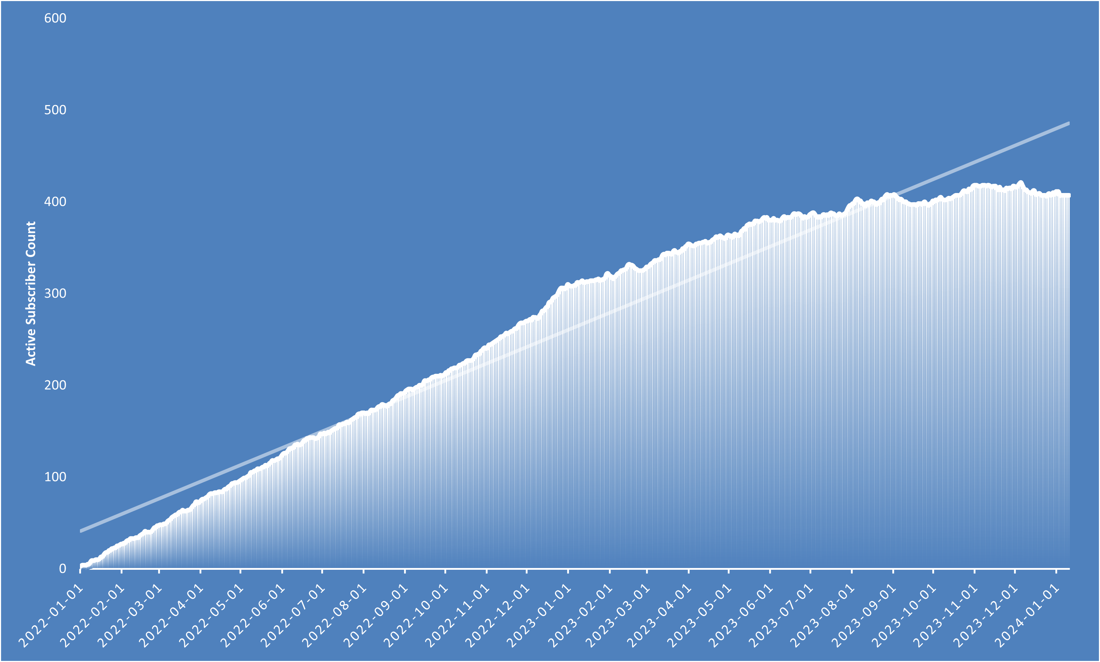
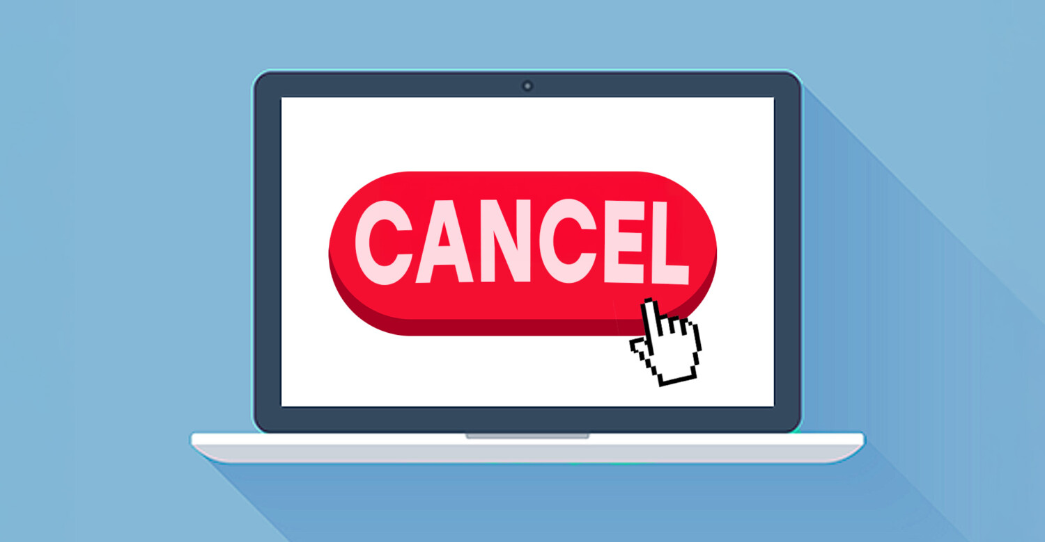
Active Subscribers – Growth Curve
• The curve flattening indicates churn starting to match new subscribers.
• This is an early warning of a retention issue, not an acquisition problem.
Magic Subscription Board Report Overview
Notes:
This chart shows the day‑to‑day number of active subscribers. Rising early, then flattening. A flattening line means cancellations begin offsetting new signups. This tells us retention, especially around renewals, is the main issue to address.

Slide 3
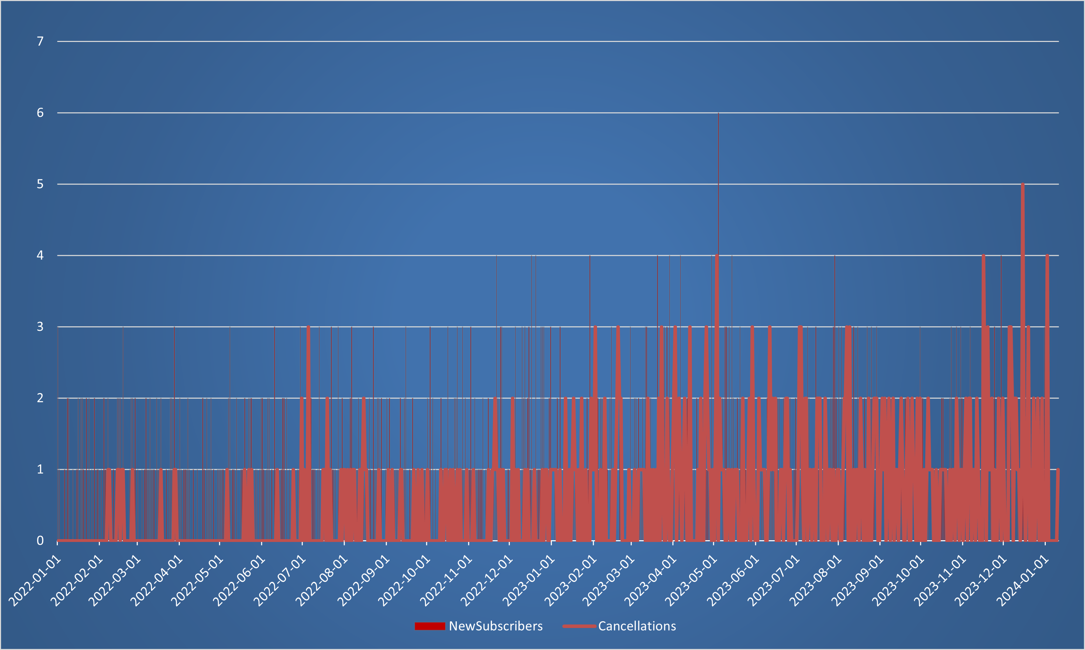

New Subscribers vs Cancellations – The 12-Month Cliff
• This matches the end of the first‑year discount period.
• Around 65–75% of all churn happens during these renewal windows.
Magic Subscription Board Report Overview
Notes:
This slide makes the retention problem very clear. Most cancellations occur around the one‑year mark. That’s when the customer loses their 10% first‑year discount and sees the full price. That sudden price jump drives the majority of churn spikes.

Slide 4
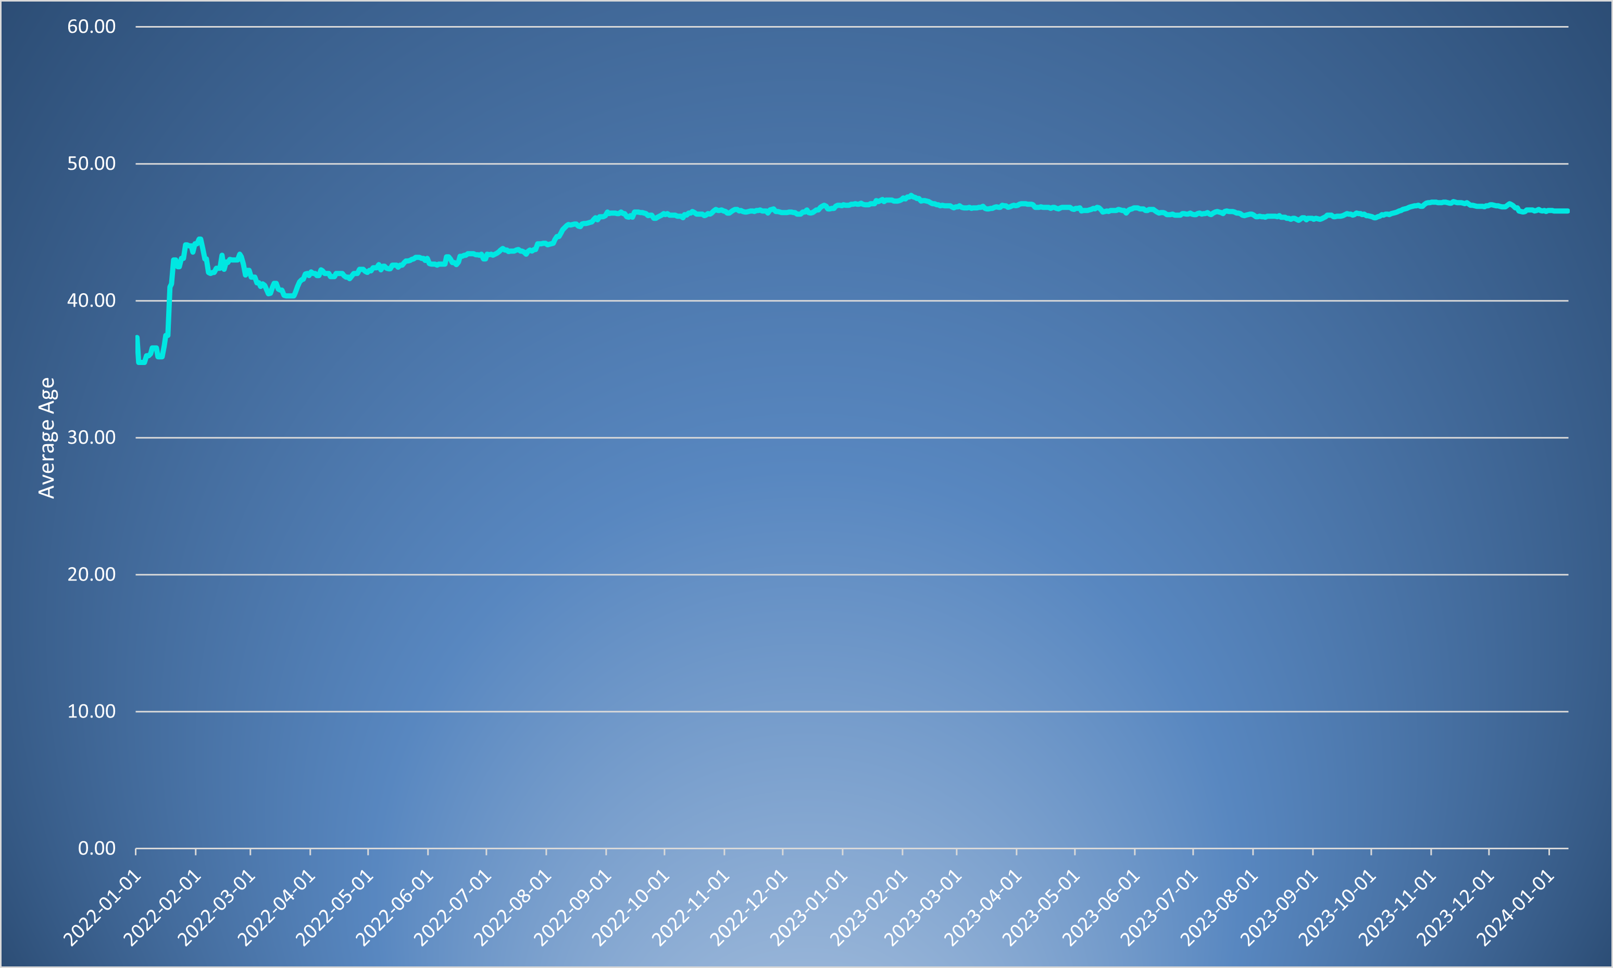
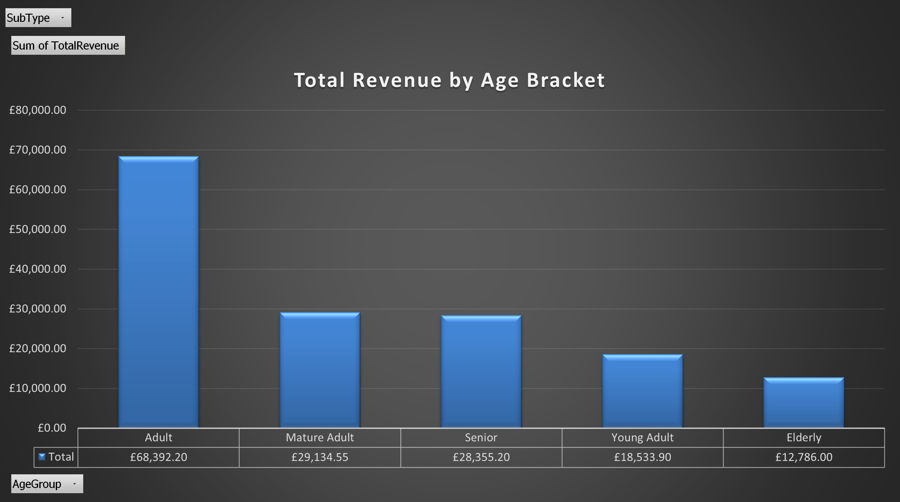
Subscriber Age Profile – Trends Over Time
• However, older customers react more strongly to sudden price increases.
• Demographic shift means renewal experience becomes more important.
Magic Subscription Board Report Overview
Notes:
This slide shows the rising average age of our customer base. Older users stay longer overall, but they are more sensitive to price changes at renewal. This means improving the renewal experience directly impacts our most stable customers.

Slide 5
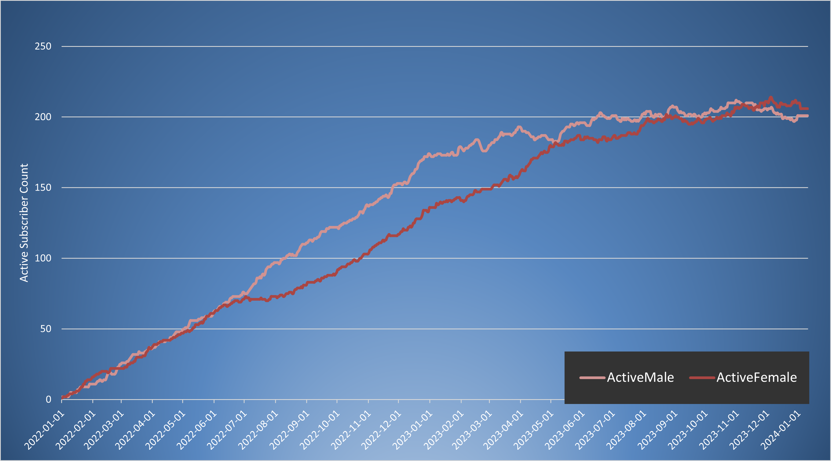

Subscribers by Gender – Retention Balance
• No major demographic risk: churn is not gender‑driven.
• Retention improvements should apply equally to both groups.
Magic Subscription Board Report Overview
Notes:
This chart shows a consistent and balanced gender distribution. Since churn doesn’t spike differently between groups, renewal improvements will influence all customers roughly equally.

Slide 6
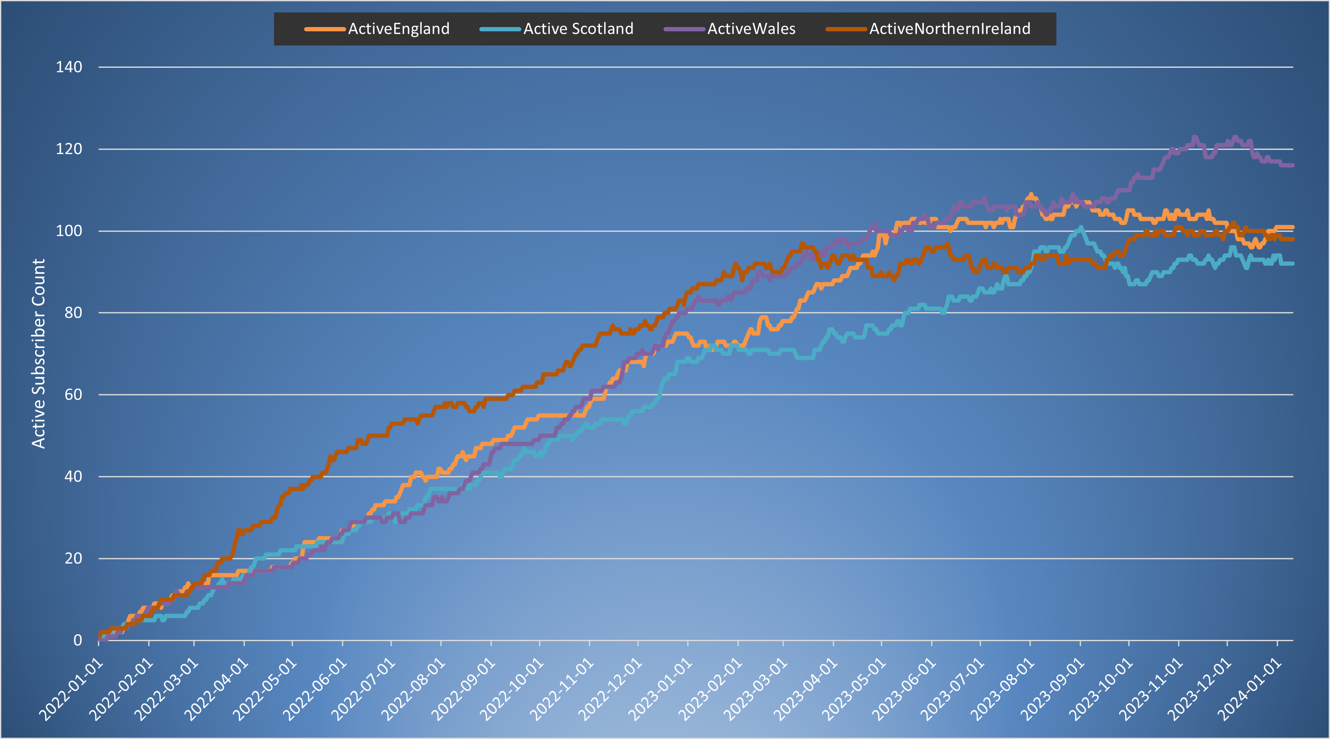
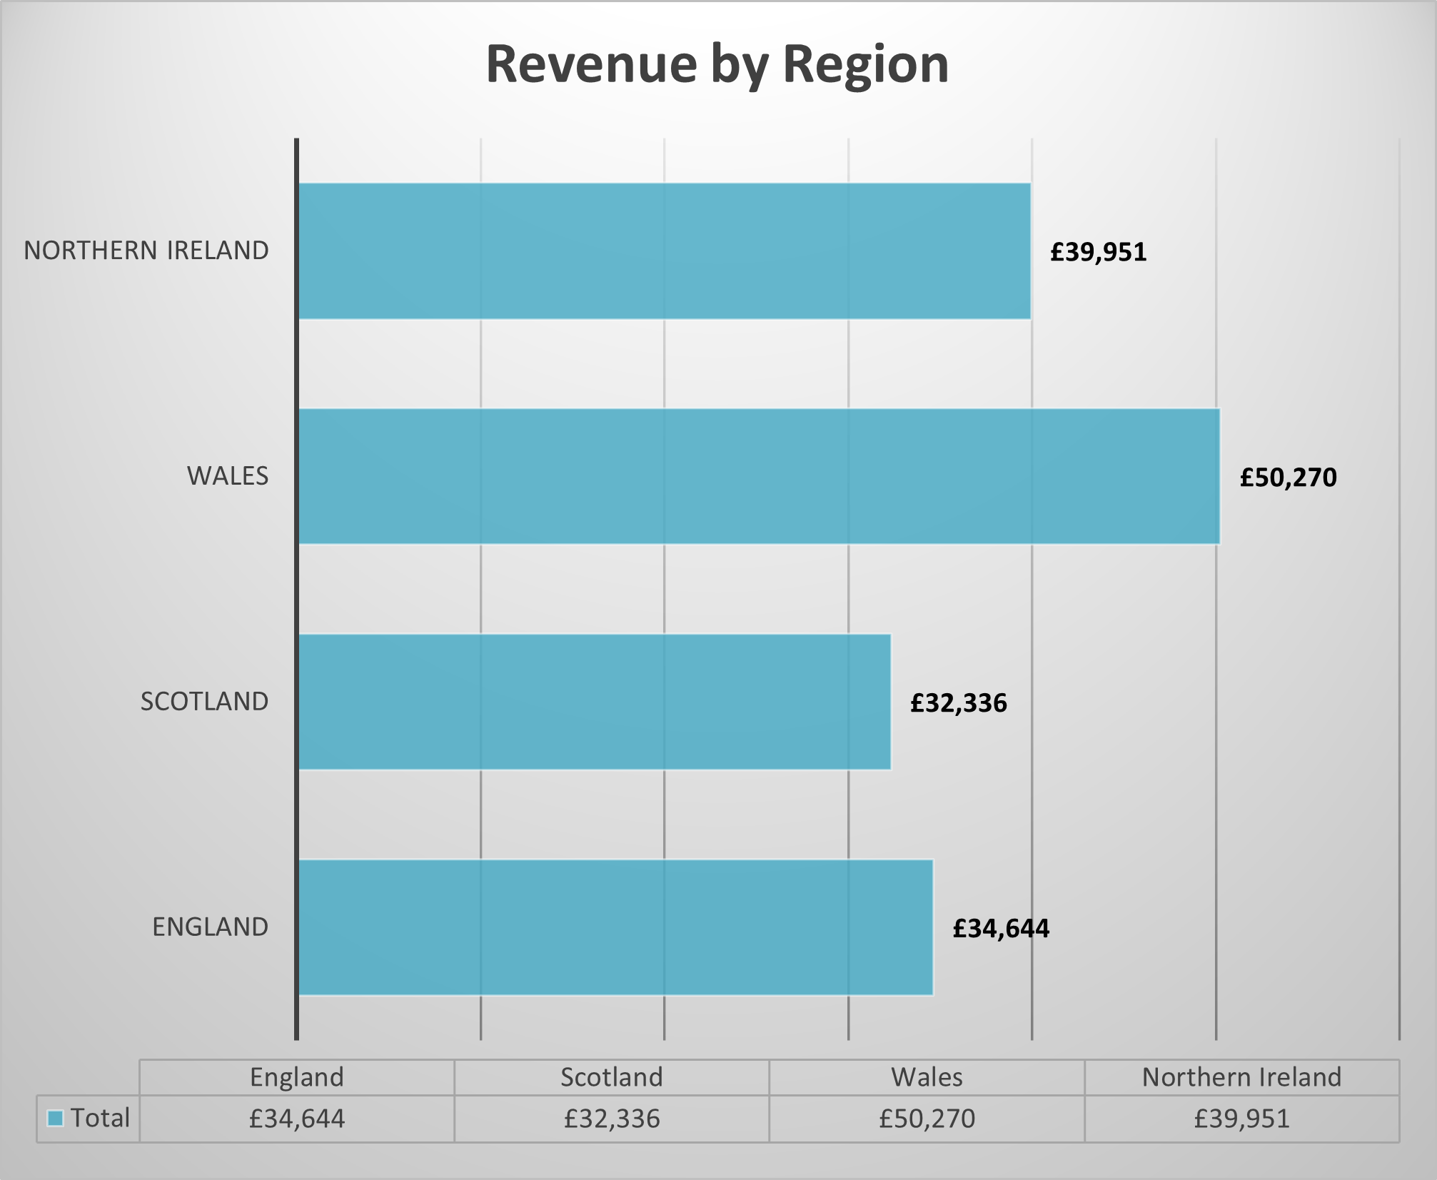
Subscribers by Region – Geographic Performance
• Regional expansion potential exists in underperforming areas.
• Smaller regions are more sensitive to churn spikes.
Magic Subscription Board Report Overview
Notes:
This shows the subscriber counts per region. England grows strongly, while Wales and Northern Ireland flatten sooner. These regions may need targeted offers or improved incentives at renewal.

Slide 7
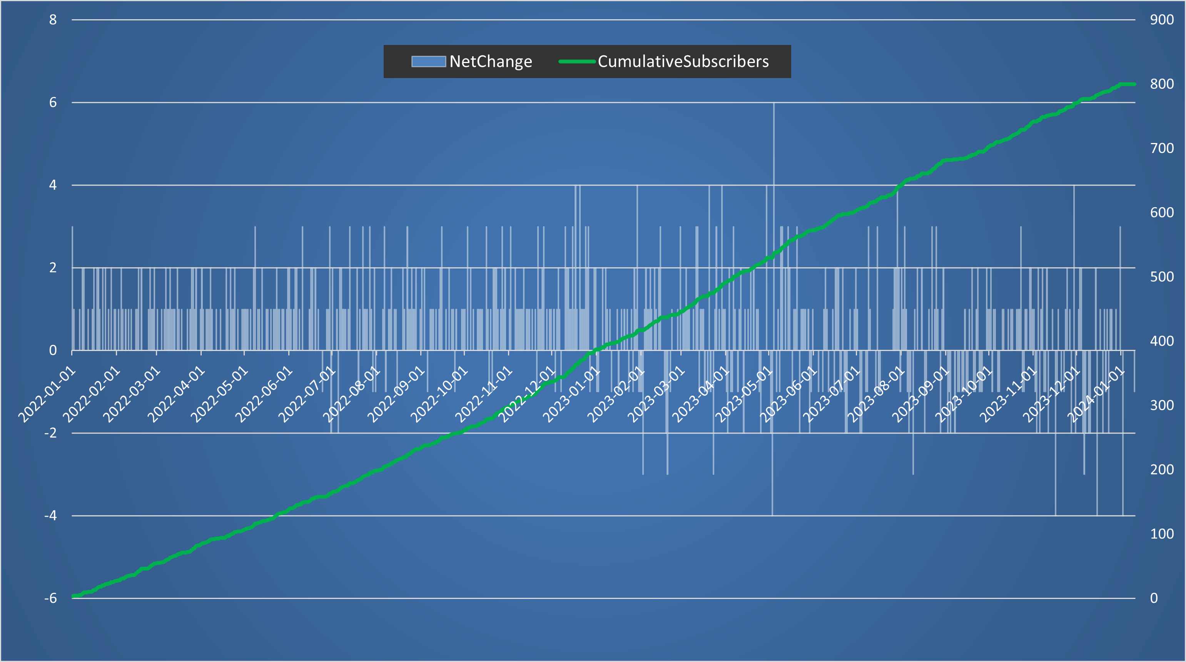
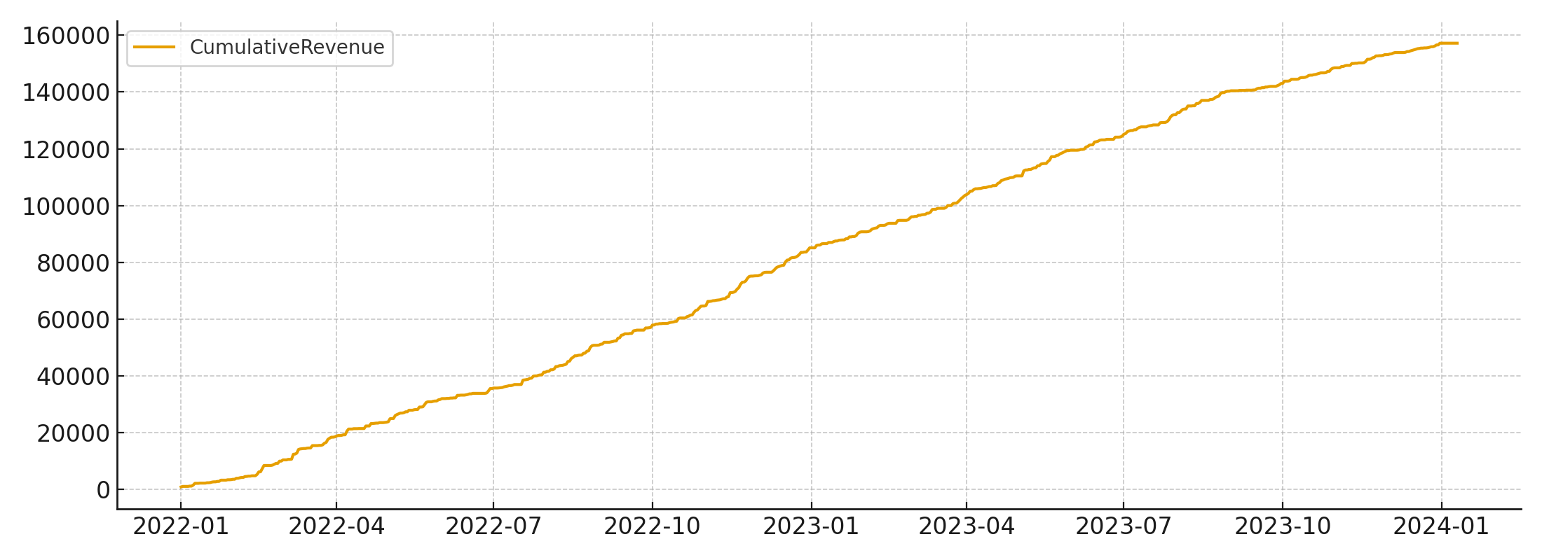
Cumulative Revenue – Momentum & Slowdown
• Revenue plateaus typically trail subscriber plateaus by several months.
• Fixing 12‑month churn directly increases revenue growth rate.
Magic Subscription Board Report Overview
Notes:
Revenue follows subscriber behaviour with a slight delay. As churn increases, revenue growth softens. By smoothing renewal pricing and improving customer communication, revenue will resume stronger growth.

Slide 8
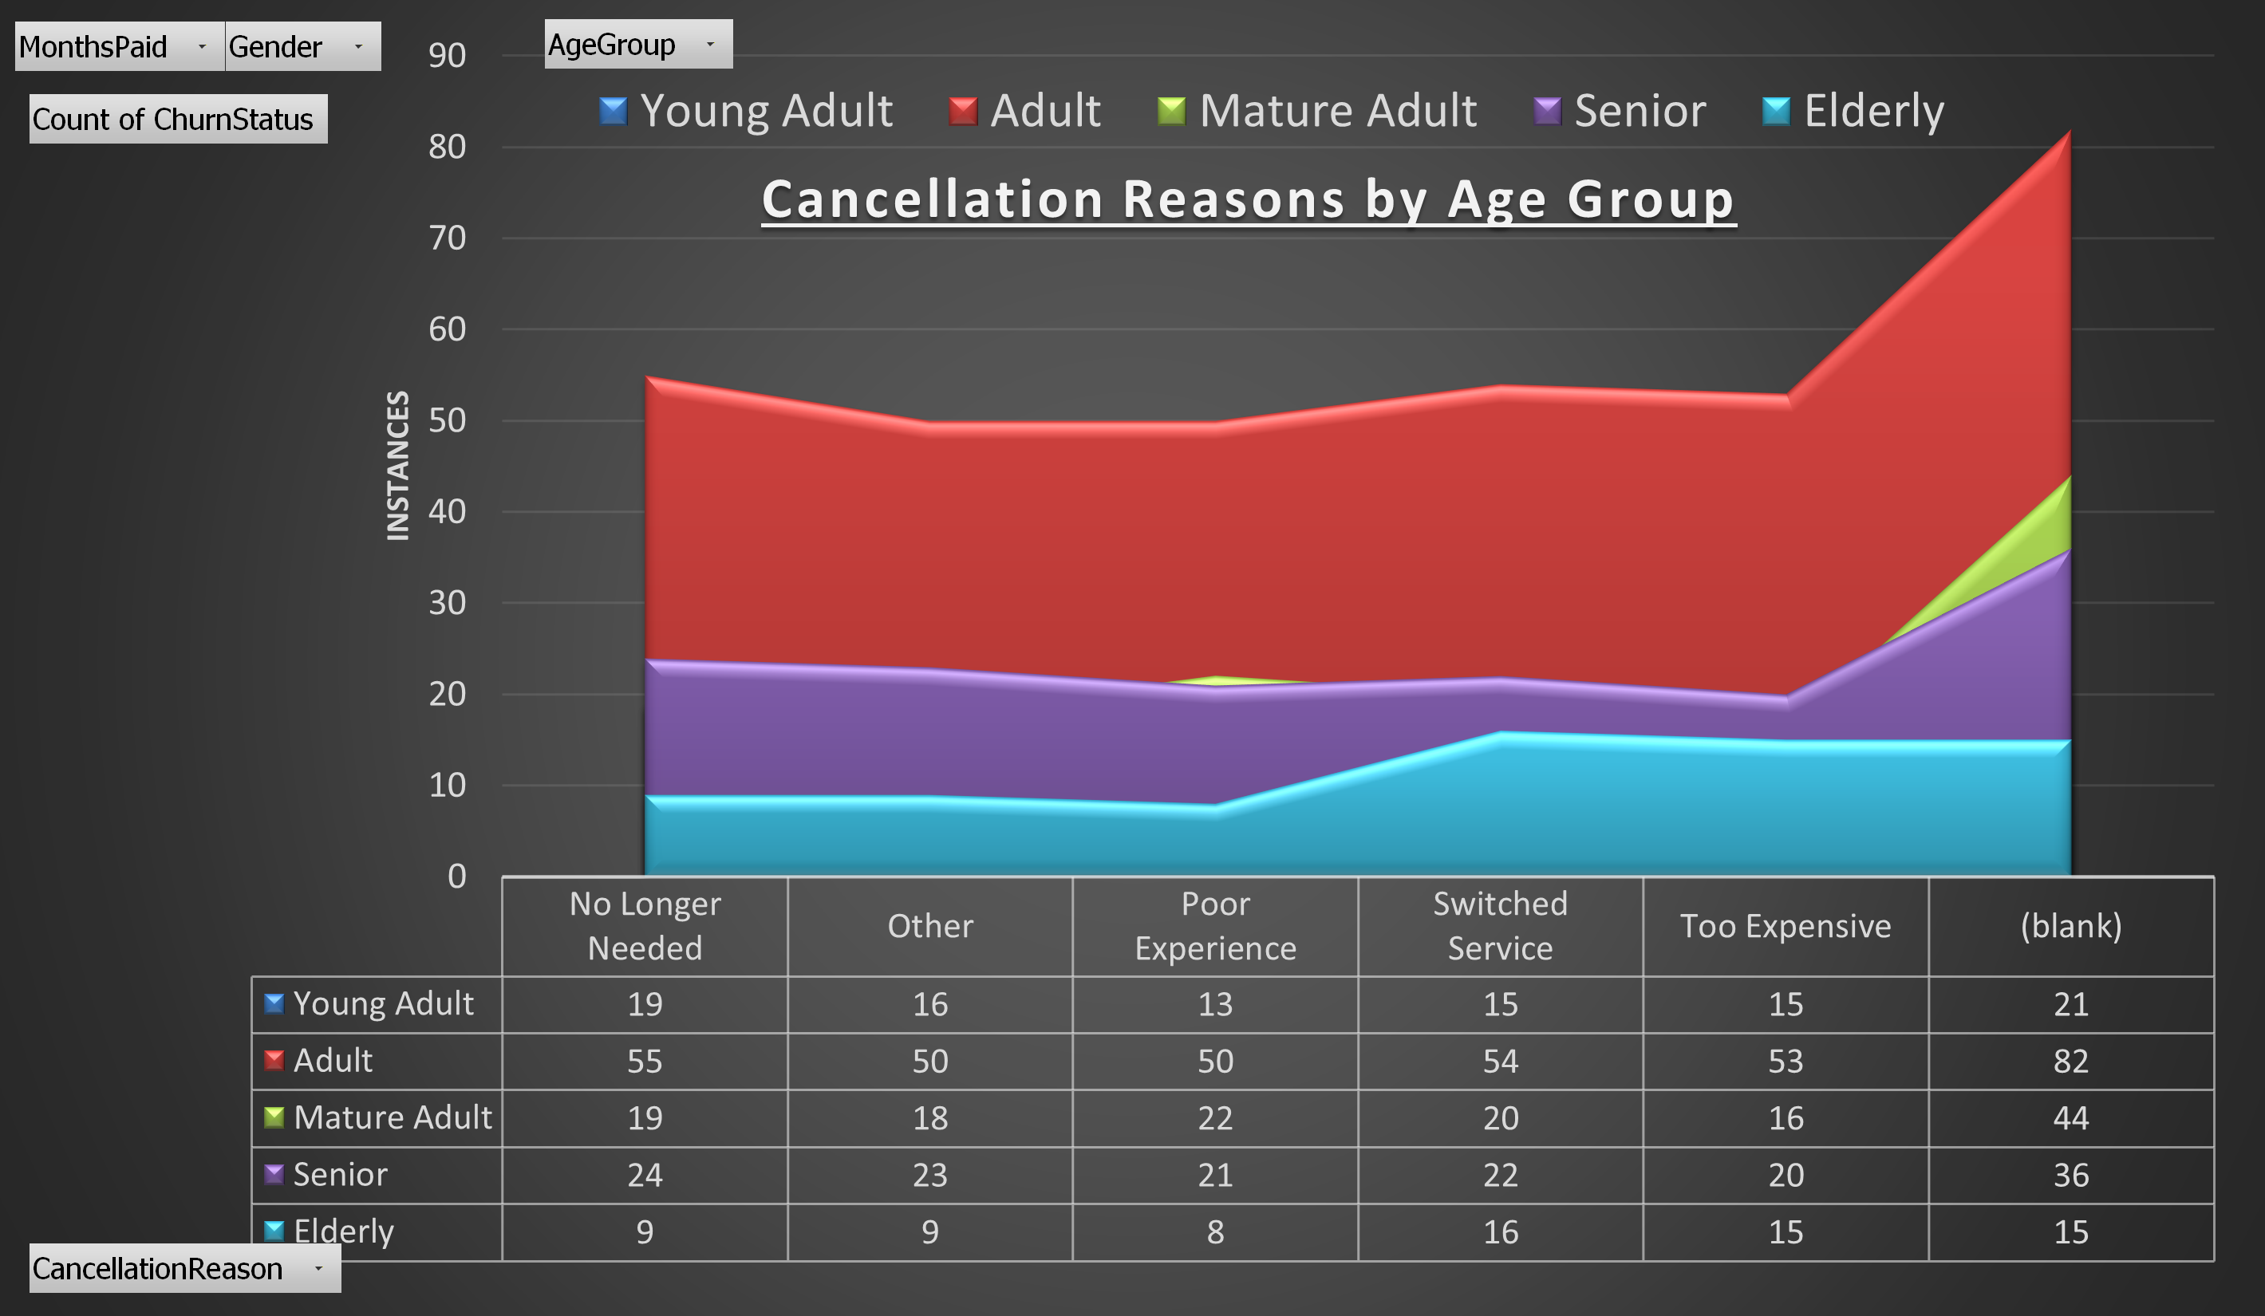
Analysis: Price Shock Why Customers Leave at Month 12
The sudden price increase may be causing 'price shock’.
• Younger customers are most likely to leave.
• Renewal communication is limited and ineffective.
• Fixing this is the single biggest growth lever we have.
Magic Subscription Board Report Overview
Notes:
Customers get used to a lower price for a whole year. When that price jumps, many leave immediately. This is behavioural economics 101: sudden price changes cause cancellations. A smoother, more predictable renewal keeps more people subscribed.

Slide 9
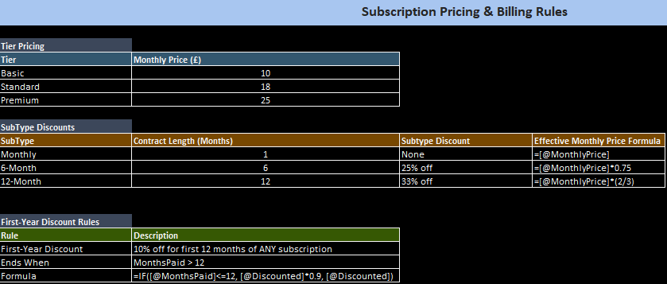
Analysis: Price Shock Why the Month-12 Price Shock Happens
Key Points:
• First-year model stacks two discounts: subtype discount + 10% new-customer discount. • At Month 12, users lose both discounts simultaneously → sudden price jump.
• Effective monthly price increase ranges from +33% to +55% depending on tier.
• Current structure rewards acquisition but penalises renewal behaviour.
Magic Subscription Board Report Overview
Notes:
This image shows the core issue behind our Month-12 churn spike.
The current model stacks two discounts during the first year: the subtype discount and the 10% ‘first-year’ discount. When both disappear at Month 12, customers experience a very sharp price increase.
Depending on the tier, this can be a jump of 33%, 40%, even over 50% for some subscribers. From the customer’s perspective, that increase feels sudden and unplanned, and we see that directly reflected in the timeline charts — churn spikes right as this discount ends.

Slide 10
Analysis: Price Shock What Competitors Are Doing
• Most major subscription services now use soft landings, not sudden jumps.
• Some offer 12–24 month “price lock” agreements to reduce churn.
• Many SaaS and consumer apps use loyalty scaling — prices rise slowly over time.
• Streaming & gym memberships increasingly use “evergreen discounts” to retain users.
small, ongoing discount that stays active for as long as a customer remains subscribed.
Magic Subscription Board Report Overview
Notes:
Competitors in the wider subscription market have moved away from these ‘cliff-edge’ pricing structures. Instead, they’re adopting soft landings: either phasing out the discount, or replacing it with a smaller loyalty rate.

Slide 11
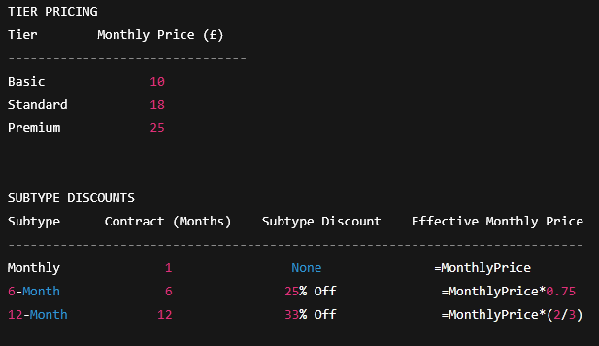
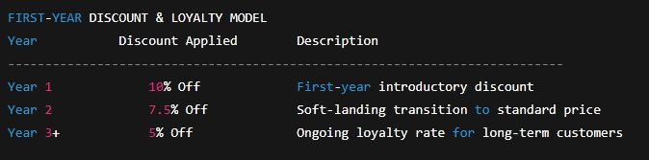
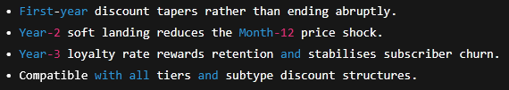
Analysis: Price Shock Possible Improvements to the Model
Analyst Suggestions:
• Phase out discounts gradually instead of removing them instantly at Month 12.
• Convert the first-year discount to a “loyalty rate” that tapers, not drops.
• Keep a milder ongoing discount for long-term customers (e.g., 5%).
• Allow customers to lock in a rate for multi-year commitments.
Magic Subscription Board Report Overview
Notes:
“These changes soften the Month-12 price jump and align us with competitor best practices.
A tapering loyalty rate removes the cliff-edge effect, improves renewal behaviour, and stabilises churn without reducing long-term revenue.”

Slide 12
Scenario A – Baseline Outlook (No Changes)
Our current subscription data model points to these outcomes:
• Growth plateaus by mid-2024.
• Month-12 churn remains high.
• Active subscribers flatten, then slowly decline.
• Revenue growth slows significantly.
• Smaller regions begin to contract.
• Customer lifetime value stays low.
Magic Subscription Board Report Overview
Notes:
Scenario A represents what happens if we don’t change anything about our current subscription model.
What we see in the data is that growth begins to plateau around mid-2024. Month-12 churn remains consistently high because the pricing structure still creates that sudden step-change in cost.
As a result, the active subscriber count levels off and then starts to decline. Revenue continues to rise, but the rate of growth slows sharply, because we’re losing too many customers right at the renewal point.
Smaller regions in particular begin to contract—it becomes harder to sustain momentum where acquisition numbers are already low.
The big picture is that customer lifetime value stays low, and the business shifts from a growth trajectory into more of a maintenance mode. That’s the risk of staying with the current model.

Slide 13
Scenario B – Improved Renewal Experience
• If renewal is smoothed, retention increases significantly across demographics.
• Older subscribers offer high lifetime value but are more price sensitive.
• Regions with weaker acquisition pipelines are hit harder by churn spikes.
• Forecast modelling shows improvement scenarios restore healthy growth.
Magic Subscription Board Report Overview
Notes:
Scenario B explores what happens when we smooth the renewal stage, instead of allowing that sharp price jump at Month 12.
Across all demographics, retention improves noticeably. We particularly see a strong effect among older subscribers: they offer high lifetime value, but they’re also more price sensitive. When the increase is softened, they’re far more likely to remain subscribed.
We also see a positive impact regionally. Areas with weaker acquisition pipelines—such as Wales and Northern Ireland—are currently hit hardest by churn spikes. Under Scenario B, those spikes reduce, which helps stabilise their subscriber base.
And most importantly, the forecast models show that by reducing the renewal friction, overall growth returns to a healthy upward trend.
In short, smoothing the renewal experience directly strengthens retention and restores momentum without changing the core product.

Slide 14
Scenario C – Retention-Focused Transformation
Full loyalty model + improved onboarding + targeted regional strategy
• Better onboarding for younger customers
• Region‑specific renewal offers
• Long‑term loyalty discounts
• Renewal churn reduction: 40–50%
• 2024–2025 growth returns to early‑2023 levels
• Revenue growth improves 2–3× baseline
• Customer lifetime value increases significantly
Magic Subscription Board Report Overview
Notes:
Scenario C looks at what happens when we make a more comprehensive shift toward a retention-first strategy.
The first component is strengthening onboarding for younger customers. They currently churn at higher rates, so improving their early experience has one of the biggest impacts on long-term value.
The second lever is region-specific renewal offers. Our data shows that churn is not uniform across locations. Customising the renewal experience for weaker regions helps stabilise their subscriber base and prevents contraction.
Third, we introduce long-term loyalty discounts. This gives customers a clear benefit to staying with us beyond Year 1 and Year 2, and it removes the ‘cliff-edge’ pricing effect entirely.
When we model these changes together, the results are significant. Renewal-stage churn drops by 40 to 50 percent, which is a substantial improvement over both the baseline and Scenario B.
As a result, overall growth in 2024 and 2025 returns to levels we were seeing in early 2023. Revenue growth strengthens—roughly two to three times the baseline—and customer lifetime value rises meaningfully.
In short, Scenario C doesn’t just fix the Month-12 problem. It shifts the entire subscription model toward long-term stability and sustained growth.

Slide 15
Recommended Strategic Actions
• Introduce loyalty pricing options for long‑term customers.
• Begin renewal communication 60–90 days before month 12.
• Use targeted offers for regions with lower retention.
• Improve onboarding flow for younger subscribers.
• Implement churn‑risk scoring to identify at‑risk users.
• Run controlled tests on pricing strategies to measure impact.
Magic Subscription Board Report Overview
Notes:
On this slide, we’ve outlined the core actions that will have the biggest impact on improving retention and stabilising long-term growth.First, introducing loyalty pricing gives long-term subscribers a clearer sense of value. It replaces the sudden price jump with a predictable, steady progression and directly addresses the churn spike we see at Month 12.
Next, renewal communication is essential. Starting the conversation 60 to 90 days before renewal gives customers time to understand what’s changing and reduces the ‘surprise’ factor that currently drives cancellations.We also recommend targeted offers for regions with lower retention. The data shows that churn is not evenly distributed, so regional incentives can help balance growth.
Improving onboarding for younger subscribers is another lever. Younger customers show higher churn overall, so a better early experience can meaningfully increase their long-term value.
The next step is implementing churn-risk scoring. This allows us to identify at-risk users early and intervene with the right offer or message before they cancel.Finally, we should run controlled tests on pricing strategies. This includes A/B testing discount tapering, communication timing, and loyalty incentives. These experiments will show, with evidence, these changes may drive the best retention outcomes.
Taken together, these actions shift our model from reactive to proactive — prioritising long-term subscriber value and reducing the volatility we see today.

Slide 16
Board Decision Summary
Trial improved renewal communication and customer journey.
Approve development of churn‑risk scoring model.
Test targeted campaigns for high‑churn regions.
Approve research for subscription discount journey remodelling.
Approve A/B testing budget for pricing and retention trials.
Support investment in retention infrastructure to enable Scenario C.
Magic Subscription Board Report Overview

